Slide 1
Week 12: Moral Dilemmas
Concepts, Principles, and Steps for analyzing and resolving moral dilemmas
From Rushworth Kidder’s How Good People Make Tough Choices
Also refer to Boss’s chapter 9 – Moral Arguments reading + pages 105-106 of the course text

Slide 2
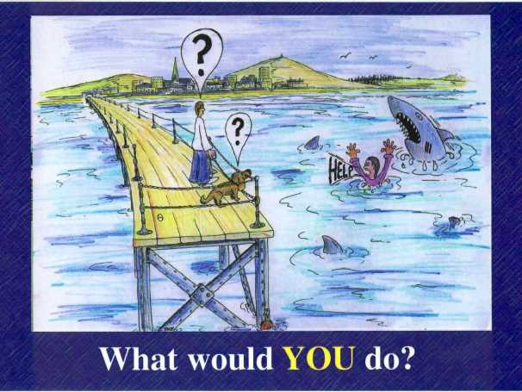
Tough choices
Don’t centre on right vs wrong
But on
RIGHT vs RIGHT
They become genuine dilemmas if both options tug at our values where we know what ought to be done.

Slide 3
Four Common Dilemmas
Models or paradigms:
Truth vs loyalty
Individual vs community
Short-term vs long-term
Justice vs mercy

Slide 4
Types
Truth vs loyalty:
Honesty, candor, or integrity vs commitment, responsibility, and promise-keeping
Individual vs community:
us vs them / self vs others / smaller vs larger
Short-term vs long-term:
Now vs then – immediate desires running counter to future goals/prospects
Justice vs mercy:
Fairness, equity, and even-handed application of the law in conflict with compassion, empathy, and love

Slide 5
Principles for decisions
From the traditions of moral philosophy – covered in chapters 8, 9, and 10
Ends-based (consequences)
Rule-based
(obligations)
Care-based
(moral ideals)
Reading from Kidder
- posted in weekly folder for your reference

Slide 6
Three Principles for Resolving Dilemmas
Do what’s best for the greatest number of people (connects to ends-based thinking – or consequences)
Follow your highest sense of principle (connects to rule-based thinking – or obligations)
Do what you want others to do to you (connects to care-based thinking – or moral ideals)
Refer to reading posted in weekly folder

Slide 7
9 Steps for Decision-making
Refer to the reading posted in the weekly folder – pp.181-184 (Kidder)
Recognize that there is a moral issue
Determine the actor
Gather the relevant facts
Test for right-vs-wrong issues
Test for right-vs-right paradigms
Apply the resolution principles
Investigate the “trilemma” options
Make the decision
Revisit and reflect on the decision.

